Slide 1




EPT: International Roaming Packages - Future Vision
Nov xx, 2015

Slide 2
Opportunity
Customers are struggling when navigating the digital experience for international packages. Many customers end up calling CSR for help understanding key aspects (i.e. coverage, purchase, usage) of international packages versus leveraging digital channels.
Goal:
Help define a long-term vision of the digital experience for AT&T’s international roaming packages that will provide customers with a clear, simple, personalized experience across the digital space resulting in…
Increase usage of digital channels, such as att.com/myatt
Bolster customer’s confidence in decision making and purchasing of packages
Strengthen customer relationship by providing a more personalized experience
Reduce CSR engagement
Help increase sales

Slide 3










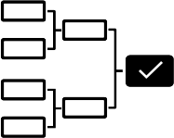

Activities and Deliverables
Research
Define and Ideation
Create and Validate
Focus Group Discussion
Persona Development
Paper Prototype
Journey Mapping
Customer Collaboration Session
CSR Interviews
Mental Modeling
Production Usability Study
Desktop Prototype
Early Mockups / Flows
Competitive Analysis
Usability Study
Content Opportunities

Slide 4

Research

Slide 5


Research Activities
Key Insights
Simple, easy with no surprises.
Do, or are willing to modify usage habits while traveling.
See it as a ‘shared plan’ versus a device feature.
Package vs. Plan vs. Feature confusion
Differentiating Passport from Cruise.
Need for a stronger mobile experience (purchase and usage)
Lack of confidence in decision making.
Understand data usage and package/plan options.
Understanding how timing, usage and features (i.e. voicemail) can impact charges
Focus Group Discussion
CSR Interviews
Production Usability Study

Slide 6
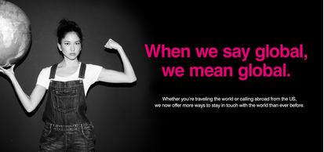
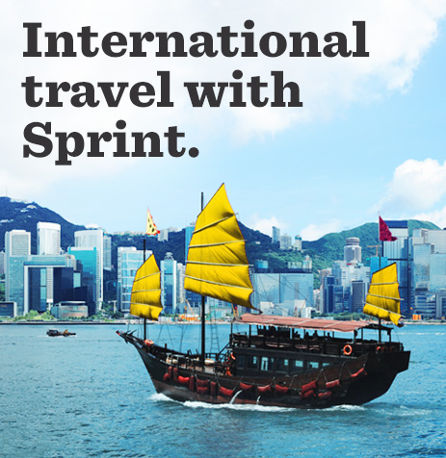




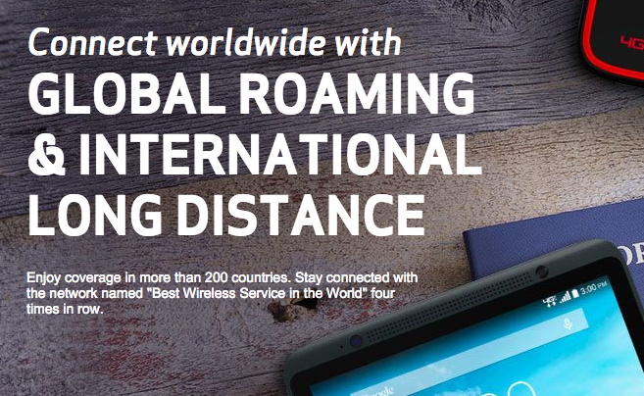
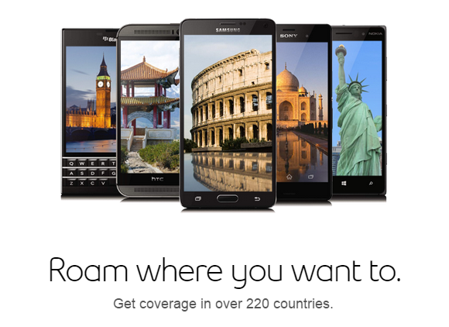
What are they doing?
Guided Flows
Associating to device
Single page experience
Easy Navigation
What aren’t they doing?
Solid Mobile Experience
Easy access to helpful information
Consistent terminology
Research Activities
Competitive analysis

Slide 7

Voice of the Customer

Slide 8
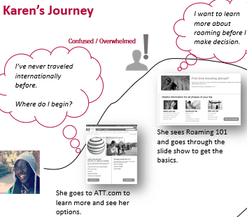

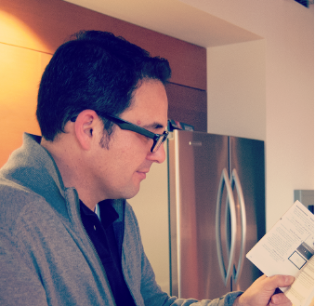
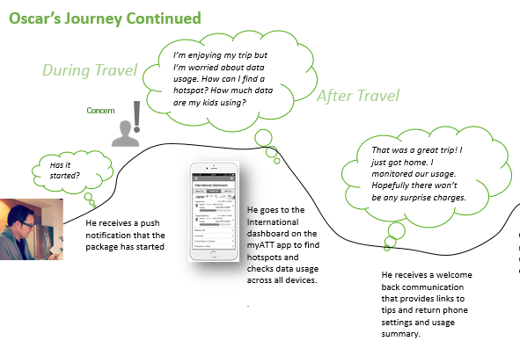


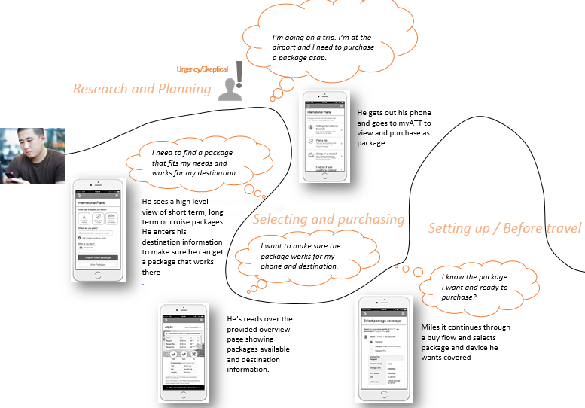
Voice of the customer
Usage/Support, Options, Research and buying
“I should just be able to go through a wizard that I enter my countries, dates and then based on my usage, it would recommend a package for me”
Karen (Primary)
Novice to Technology
New to International Travel
“I usually start online trying to find the latest info. Cost is important of course, there are lots of options out there.”
“Apps using data in the background”
“The Passport only gives you an alert if you are near a hotspot. But it should monitor your usage and provide other information”
Oscar
Self-Sufficient
Moderate International Traveler
“I watch data use on myAT&T app; make that work for roaming”
“Surprise when you get back”
Miles
Tech Savvy, Self-Sufficient
Seasoned International Traveler
Notes:
To help define a vision for International, we needed to understand the customer and their journey with AT&T.
-Leverage research findings by applying the ‘lens of international customer’ to our existing design personas to help create journeys and mental models that would frame pain points, needs and goals.
-Use these artifacts to direct our designs and to provide empathy for those customer’s experiences.
Three primary personas were created spanning across travel and technology experience.
Personas and their journeys were developed using insights from research.
Understanding of products and IR, confidence in decisions, access to information are some of the key pain points being addressed.

Slide 9
Personas
Needs/Expectations
Concerns/Pain Points
Karen (Primary)
Novice to Technology
New to International Travel
Where do I start?
What is the best plan for me?
What do I have to do when I get there?
How do charges work?
How do I avoid getting charged extra?
Did I purchased the right plan?
What I need to do before, during and after my trip?
Education
Guidance
Easy and understandable
Confidence
Worry-Free Travel
“I don’t want to have to think so hard on this. I should be able to go through a wizard that would recommend a package for me.”
Oscar
Self-Sufficient
Moderate International Traveler
How does this help for my trip?
Does it provide all that I need for my trip?
Are there better options out there?
How to I find clear and accurate information?
How can I have help managing usage?
How do I avoid billing surprises?
Clarity
Accessibility to information
Trust
Efficiency
“I usually start online trying to find the latest info. Cost is important of course, there are lots of options out there.”
Miles
Tech Savvy, Self-Sufficient
Seasoned International Traveler
Does it cover what I need? (location, data usage, etc.)
How well will it work there?
Are there better alternatives? (i.e. temp phone, SIM)
How can I get help finding Wi-Fi hot spots?
Where do I find information on service quality in that country?
Is there a good mobile experience for shopping and usage?
Predictability
Ease / Efficiency
Accessibility
“Predictability is very important. I used to get local SIMs, but it just isn’t worth the hassle.”

Slide 10


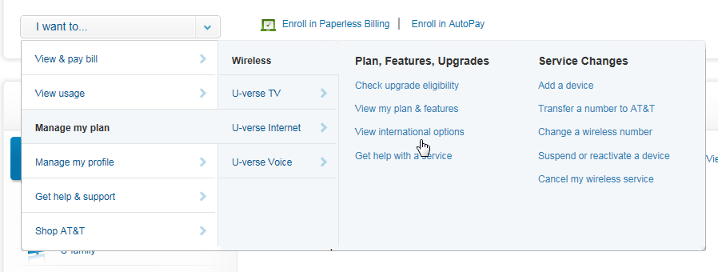

Research & Planning
□ Navigation
“I’m looking for a plan…”
Where to start?
Product Educating /
Information
Guidance
USABILITY FINDING
The I want to… menu aligned well with users’ assumption that they could find international options under the general category of Manage my plan.
Attempted to use the global navigation. Need to address this in mobile.
SELECTING & PURCHASE
Notes:
Customers need navigation that aligns to their mental model that International Features are Plans.

Slide 11
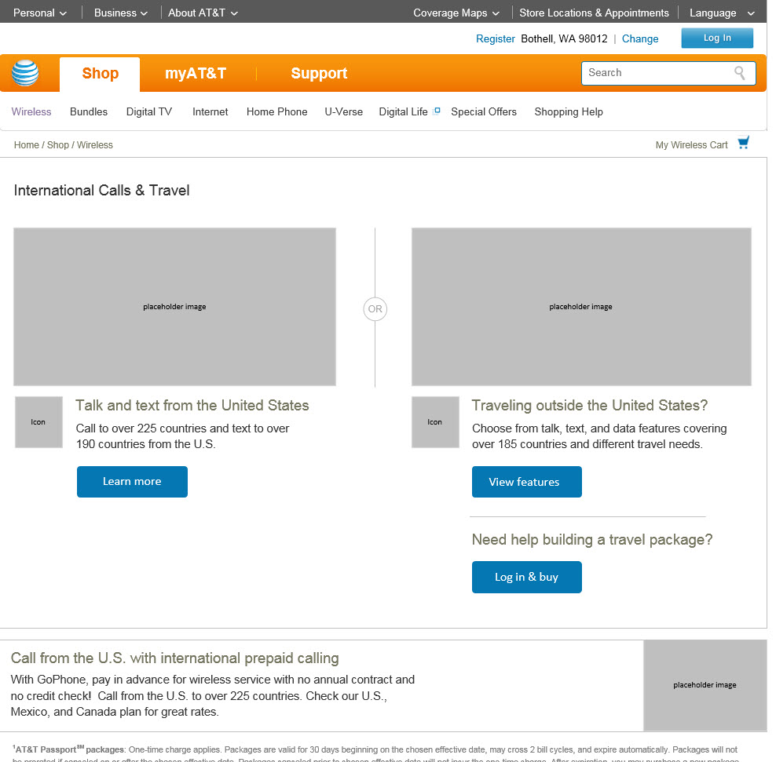
Research & Planning
☑ Navigation
□ Leading customers to the right track
(US and Traveling Splitter)
“I need a plan for my trip”
Where to start?
Product Educating /
Information
Guidance
USABILITY FINDING
Page worked well & led users to either the shop page or the guided order flow
Good split of customers wanting to immediately buy (guided flow) or view feature (shop)
SELECTING & PURCHASE
Notes:
Customers need navigation that aligns to their mental model that International Features are Plans.

Slide 12
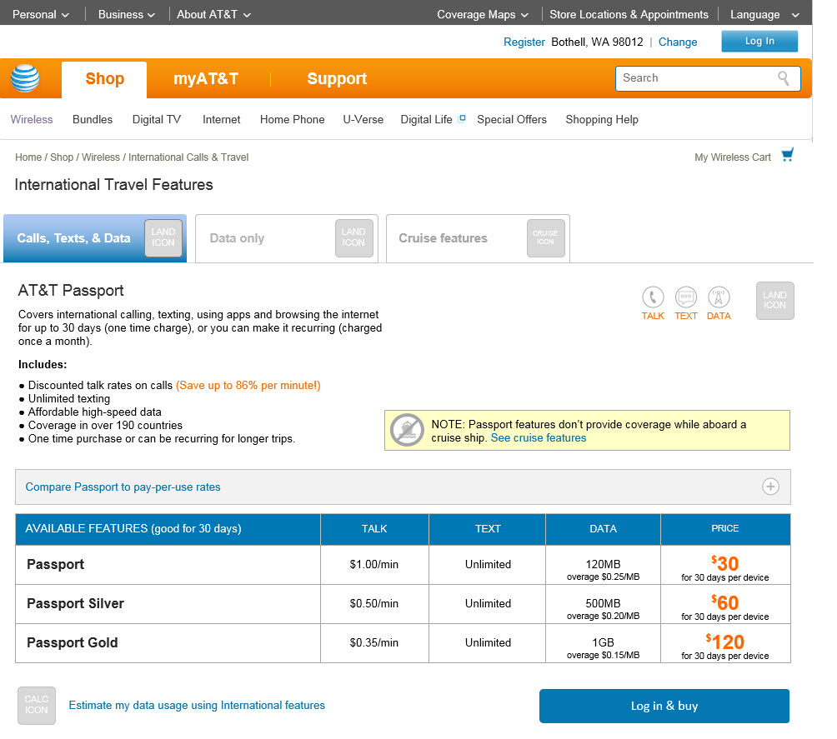
Research & Planning
☑ Navigation
☑ Leading customers to the right track
“I don’t want to have to think so hard on this”
□ Sales – Product Understanding
Education
Easy and understandable
Clarity
Where to start?
Product Educating /
Information
Guidance
USABILITY FINDING
Page layout works
Highlighted discounted rates worked
Cruise warning brought awareness
Still didn’t get talk rates
Cruise and Passport would be needed for cruising
SELECTING & PURCHASE
Notes:
Customers need navigation that aligns to their mental model that International Features are Plans.

Slide 13
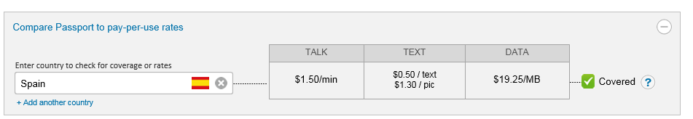
Research & Planning
☑ Leading customers to the right track
☑ Sales – Product Understanding
I’m going … is it covered?
□ Sales – Access to information and tools
Where to start?
How much data do I need?
Product Educating /
Information
Guidance
USABILITY FINDING
Opportunity for Compare PPU tool to be more prominent
Data calculator can remain secondary but should be available
SELECTING & PURCHASE
Notes:
Customers need navigation that aligns to their mental model that International Features are Plans.

Slide 14
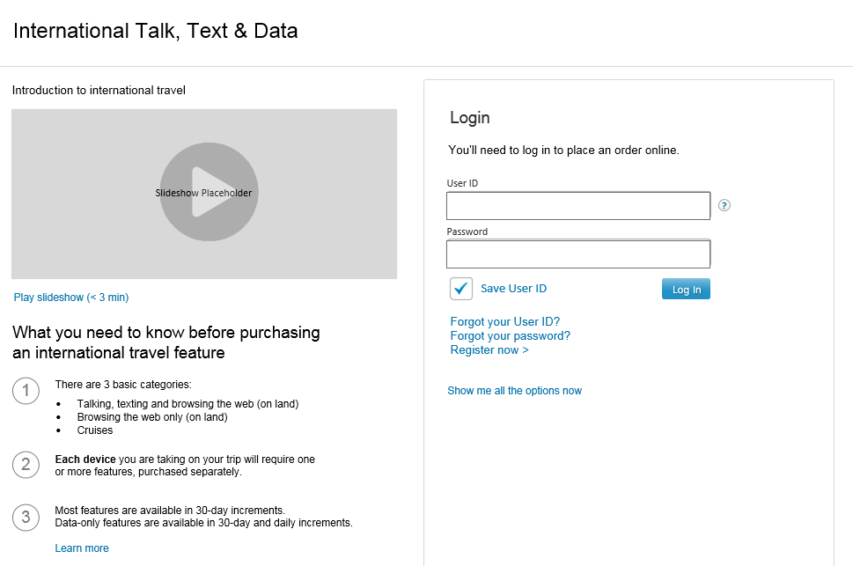
Research & Planning
☑ Sales – Product Understanding
☑ Sales – Access to information and tools
□ Steps to help make a decision
(What to expect)
Where to start?
Product Educating /
Information
Get video content recommendations from Kelly
Informing and preparing the customer
Guidance
USABILITY FINDING
Information is helpful
Like to have a video
Not a good location – apply to sale pages and access to info on buyflow
SELECTING & PURCHASE
Notes:
Customers need navigation that aligns to their mental model that International Features are Plans.

Slide 15
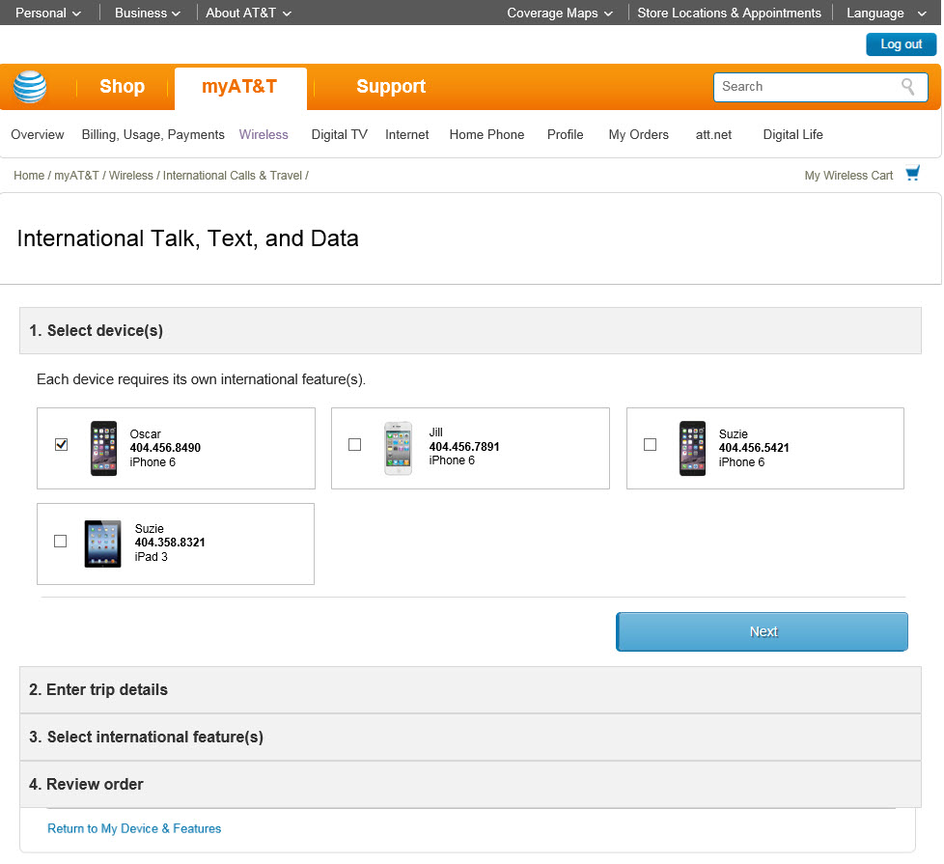
Research & Planning
☑ Sales – Product Understanding
☑ Sales – Access to information and tools
□ Steps to help make a decision
(What to expect)
Where to start?
Product Educating /
Information
Guidance
USABILITY FINDING
Supporting content is still needed and placed to catch the eye of the user (i.e. placed within section headers)
SELECTING & PURCHASE
Notes:
Customers need navigation that aligns to their mental model that International Features are Plans.

Slide 16
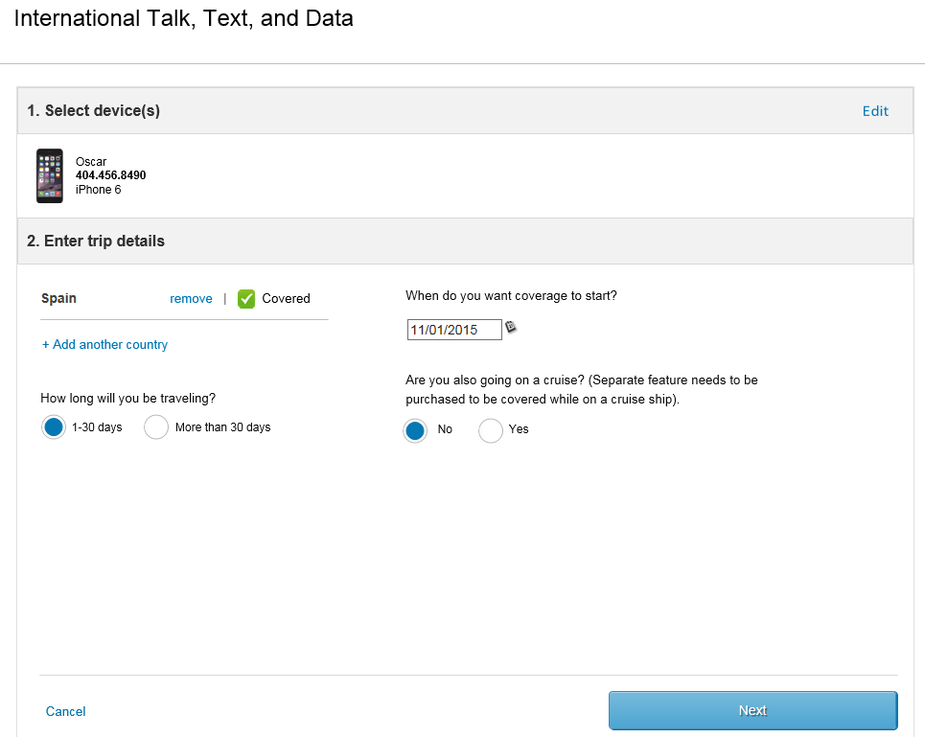
Research & Planning
☑ Sales – Access to information and tools
☑ Steps to help make a decision
I know my trip information and devices
□ Help align customer’s mental model
(to product offerings)
Where to start?
Per Device
Product Educating /
Information
Country Coverage
Package Length
Cruise needs
USABILITY FINDING
Supporting content is still needed and placed to catch the eye of the user (i.e. placed within section headers)
Guidance
SELECTING & PURCHASE
Notes:
Customers need navigation that aligns to their mental model that International Features are Plans.

Slide 17
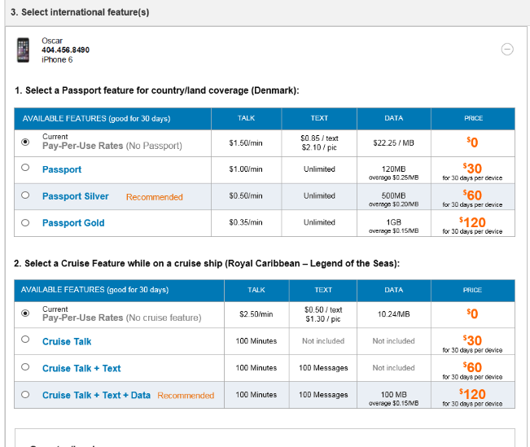
Research & Planning
☑ Sales – Access to information and tools
☑ Steps to help make a decision
I’m beginning to understand
□ Help align customer’s mental model
(to product offerings)
Where to start?
Product Educating /
Information
Need for multiple packages
Guidance
USABILITY FINDING
Enter here
SELECTING & PURCHASE
Notes:
Customers need navigation that aligns to their mental model that International Features are Plans.

Slide 18
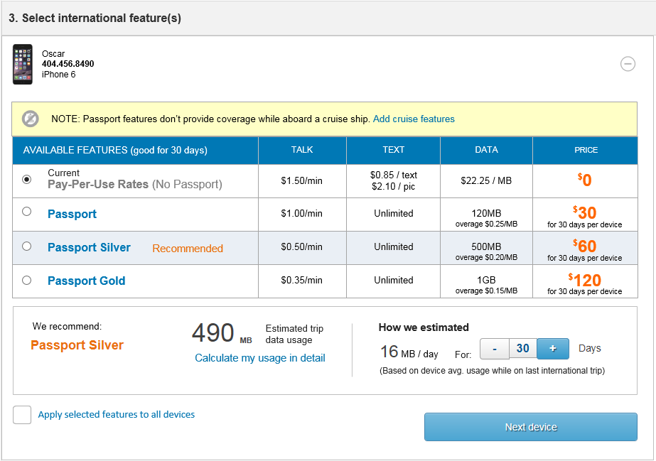

Selecting & Purchase
☑ Steps to help make a decision
How do I know what plan is right for me?
☑ Help align customer’s mental model
□ Give recommendations
Instill confidence
VOICE OF THE CUSTOMER:
“I should just be able to go through a wizard that I enter my countries, dates and then based on my usage, it would recommend a package for me”
USABILITY FINDING
[Enter here]
TRIP USAGE
Notes:
Customers need navigation that aligns to their mental model that International Features are Plans.

Slide 19
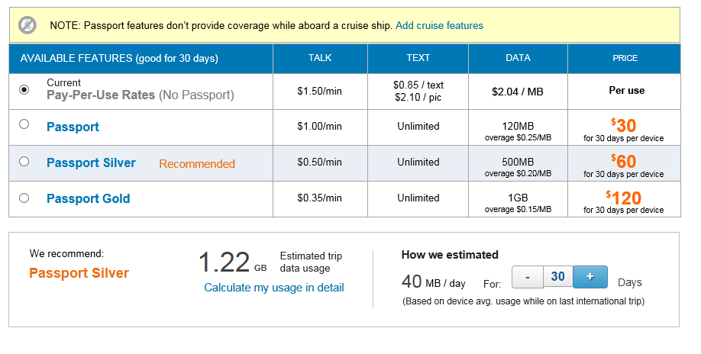
Selecting & Purchase
☑ Help align customer’s mental model
☑ Give recommendations
How do I know I can trust this ?
□ Trust with transparency
Instill confidence
VOICE OF THE CUSTOMER:
“I should just be able to go through a wizard that I enter my countries, dates and then based on my usage, it would recommend a package for me”
USABILITY FINDING
Users saw & appreciated the recommended Passport feature in the table; however…
Need clearer explanation on how it’s calculated (based on user’s history)
Better location is needed
Confusion having it associated with the calculator
TRIP USAGE
Notes:
Customers need navigation that aligns to their mental model that International Features are Plans.

Slide 20
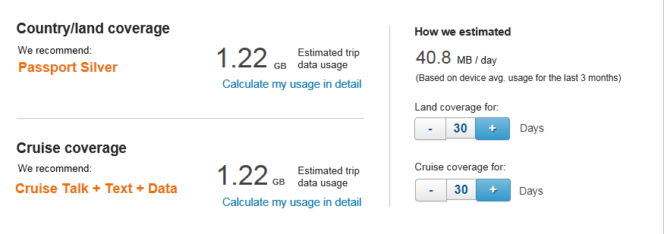
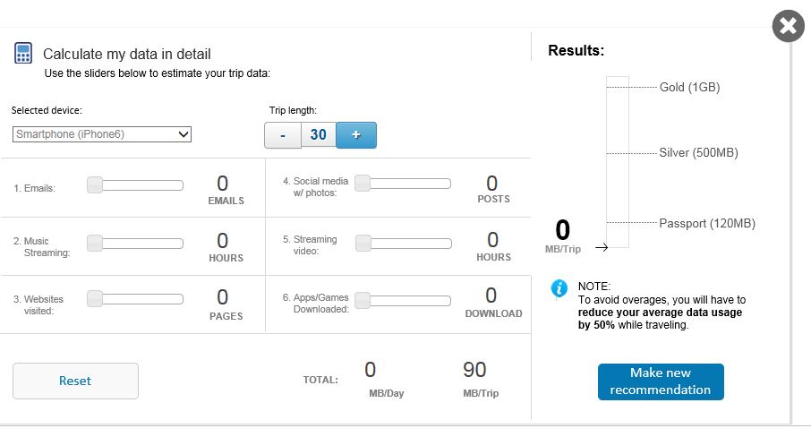
Selecting & Purchase
☑ Give recommendations
☑ Trust with transparency
□ Access to information & tools
(to help customers think about usage)
Instill confidence
VOICE OF THE CUSTOMER:
“You really have no idea how much data you are going to need”
USABILITY FINDING
(Location) Not many users gravitated towards the tool
(Level of effort) Too complex
TRIP USAGE
Notes:
Customers need navigation that aligns to their mental model that International Features are Plans.

Slide 21
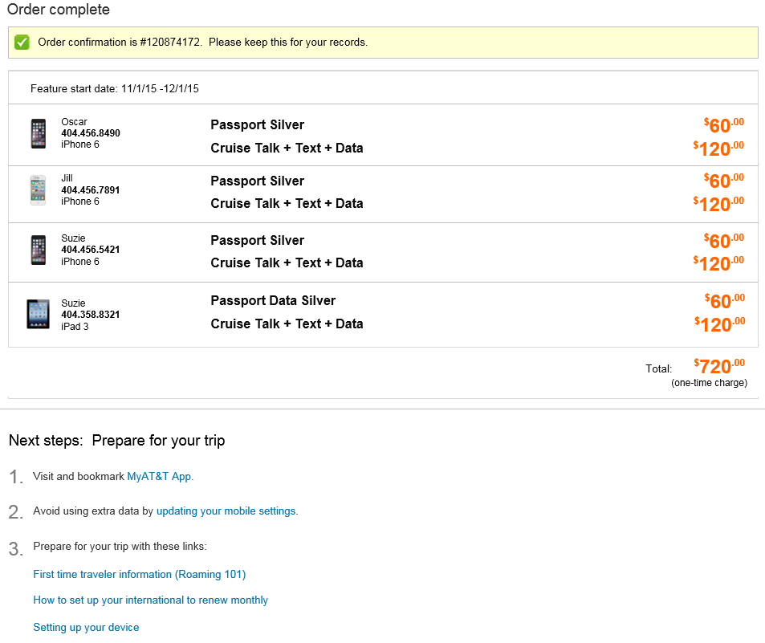
TRIP USAGE
☑ Trust with transparency
☑ Access to information & tools
Anything I need to do before my trip?
□ Post-purchase guidance
What’s next?
Preparing for trip
Supporting the traveler
USABILITY FINDING
Enter here
END OF SERVICE / BILLING
Notes:
Customers need navigation that aligns to their mental model that International Features are Plans.

Slide 22
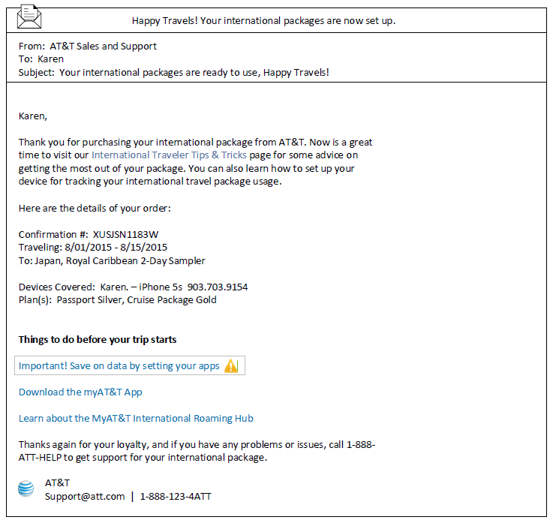
TRIP USAGE
☑ Access to information & tools
☑ Post-purchase guidance
Advice or tips on using my device?
□ Preparing the user
(with supportive communication)
What’s next?
Preparing for trip
Supporting the traveler
VOICE OF THE CUSTOMER:
“Apps using data in the background”
USABILITY FINDING
Enter here
END OF SERVICE / BILLING
Notes:
Customers need navigation that aligns to their mental model that International Features are Plans.

Slide 23
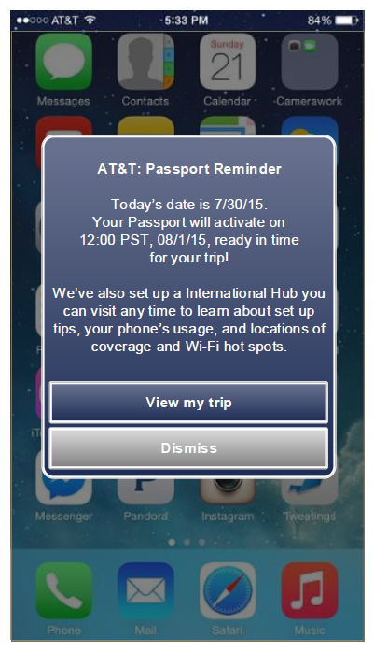
TRIP USAGE
☑ Post-purchase guidance
☑ Preparing the user
I assume that my package will start.
□ Pre-trip communication
What’s next?
Preparing for trip
Start date
Point to Hub with explanation
Supporting the traveler
VOICE OF THE CUSTOMER:
“I have no idea what the app does. I downloaded it and still don’t get it”
USABILITY FINDING
Enter here
END OF SERVICE / BILLING
Notes:
Customers need navigation that aligns to their mental model that International Features are Plans.

Slide 24
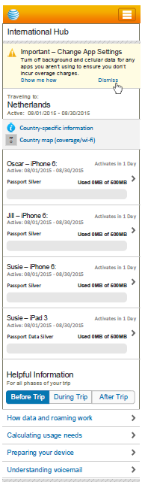
TRIP USAGE
☑ Preparing the user
☑ Pre-trip communication
I assume that my package will start.
□ International App – Before trip
What’s next?
Preparing for trip
Orientating user for travel
Before travel information
Supporting the traveler
VOICE OF THE CUSTOMER:
“The Passport only gives you an alert if you are near a hotspot. But it should monitor your usage and provide other information.”
USABILITY FINDING
Enter here
END OF SERVICE / BILLING
Notes:
Customers need navigation that aligns to their mental model that International Features are Plans.

Slide 25
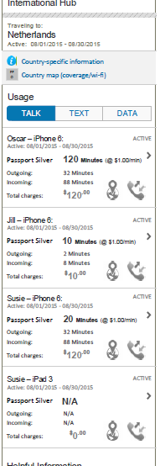
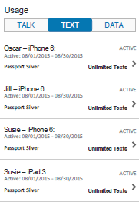
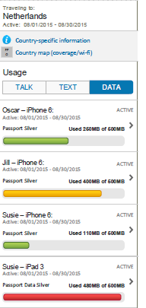
TRIP USAGE
☑ Pre-trip communication
☑ International App – Before trip
How much data am I using?
□ International App – During trip
What’s next?
Preparing for trip
Supporting the traveler
VOICE OF THE CUSTOMER:
“I watch data use on myAT&T app; make that work for roaming”
Management tools
Data
Talk
Text
Wi-Fi
Supporting information
USABILITY FINDING
Enter here
END OF SERVICE / BILLING
Notes:
Customers need navigation that aligns to their mental model that International Features are Plans.

Slide 26
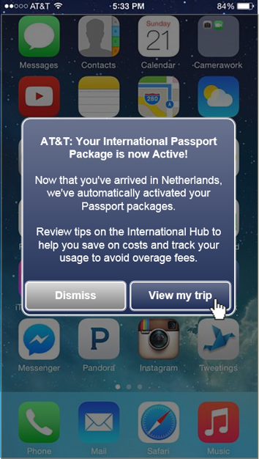
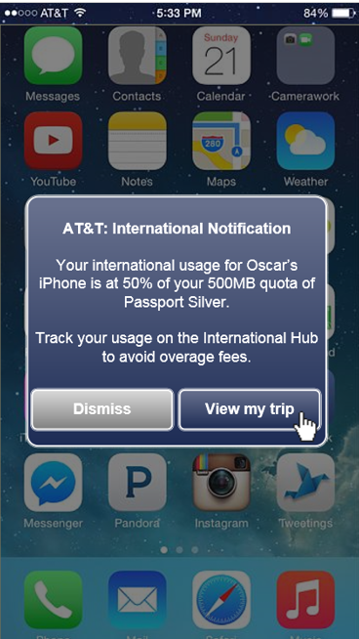
TRIP USAGE
☑ International App – Before trip
☑ International App – During trip
I can use some help so I can enjoy my trip.
□ Supportive communication
(During trip)
What’s next?
Preparing for trip
Supporting the traveler
VOICE OF THE CUSTOMER:
“I watch data use on myAT&T app; make that work for roaming”
USABILITY FINDING
Enter here
END OF SERVICE / BILLING
Notes:
Customers need navigation that aligns to their mental model that International Features are Plans.

Slide 27
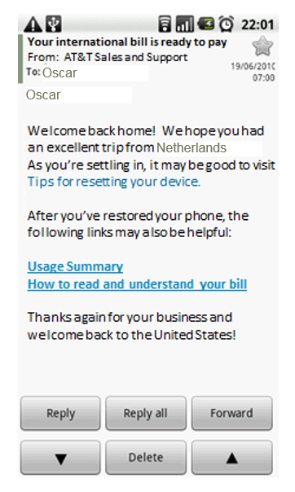
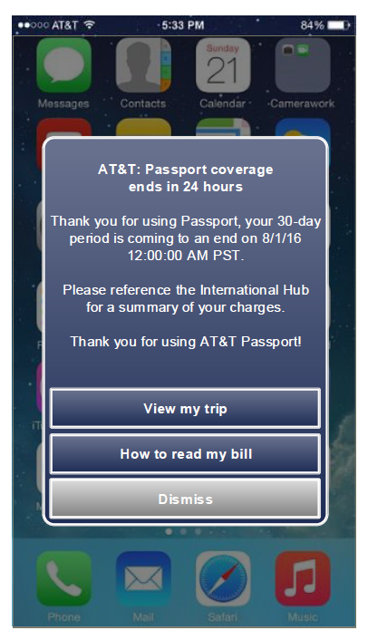
END OF SERVICE / BILLING
☑ International App – During trip
☑ Supportive communication
Is there anything I need to do now that I’m back?
□ Timely communication
(to set expectations)
Education
Instill confidence
Supporting customer
Billing guidance
VOICE OF THE CUSTOMER:
“Surprise when you get back”
USABILITY FINDING
Enter here
Notes:
Customers need navigation that aligns to their mental model that International Features are Plans.

Slide 28
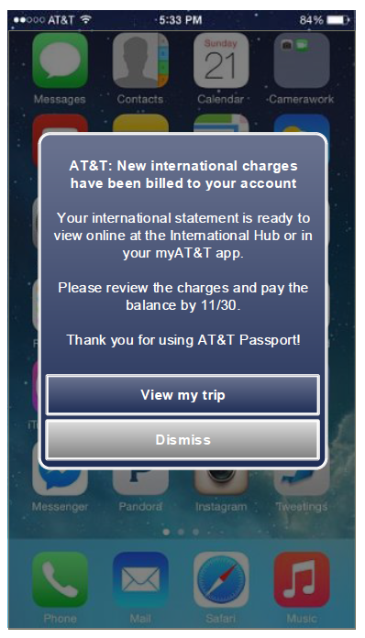
END OF SERVICE / BILLING
☑ Supportive communication
☑ Timely communication
□ Using app as a reference point
Education
Instill confidence
VOICE OF THE CUSTOMER:
“Surprise when you get back”
USABILITY FINDING
Enter here
Notes:
Customers need navigation that aligns to their mental model that International Features are Plans.

Slide 29

Usability

Slide 30
Project Takeaways and recommendations
Content is king with a complex product offering. Simple and clean designs alone will not support customers needs for clarification.
Rethink the offerings - Features and Packages terms don’t work for customer’s mental model for associating it as a plan.
Vet out a better cruise package that already includes passport features.
Rethink Passport – The branding name is inconsistent and confuses the customer
Customers like suggestions. Just be clear on how it’s determined
Customers need education. Remove the delineation between non-authenticated (sales) and authenticated (buyflow) experiences. Lead customers to education first with the ability to bypass to sales if not needed.

